Slide 1
Learning outcome 9
Excursion in to Glade, user interface builder for GTK+

Slide 2
Glade, where is it used
Used extensively with Open Source application programming to do with projects such as:
  Gnome
  Galeon
  Mozilla

Slide 3
How is XML used?
XML is used to define the layout of the User Interface.
This is then articulated in to C/C++ callbacks that need to be implimented so that the User Interface can function as desired.
Allows for a simple way to define and change user interfaces.

Slide 4
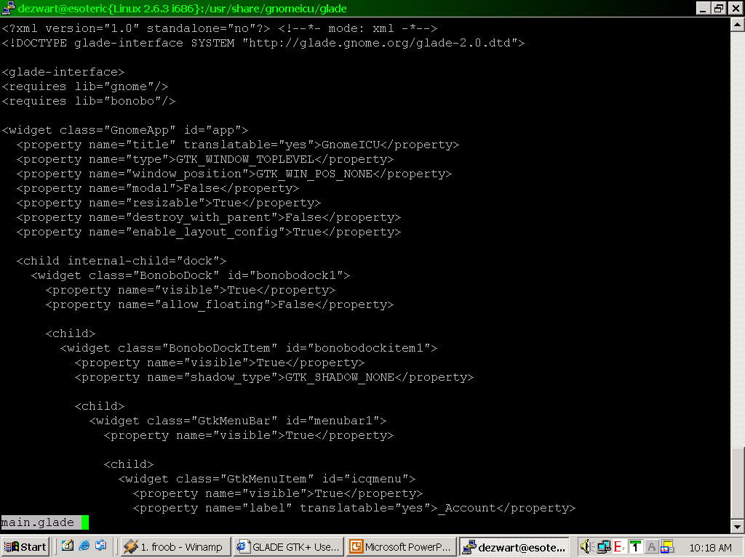
Illustrative fragment of Glade XML application

